Slide 1

Chapter 4:
Cluster Analysis in Data Mining
Notes:
‹#›

Slide 2
Hierarchical Clustering Me thods
Objective
Understand advanced hierarchical clustering techniques.
Explore CURE: Clustering Using Well-Scattered Representatives.
Learn about CHAMELEON: Graph Partitioning on KNN Graph.
Discover Probabilistic Hierarchical Clustering's probabilistic approach.
Recognize the benefits and applications of these advanced methods.
Let's uncover how these methods contribute to the complexity and sophistication of hierarchical clustering.
‹#›

Slide 3
Hierarchical Clustering Me thods
CURE: Clustering Using Well-Scattered Representatives
CURE (Clustering Using REpresentatives) (S. Guha, R. Rastogi, and K. Shim, 1998)
  Represent a cluster using a set of well-scattered representative points
Cluster distance: Minimum distance between the representative points chosen
  This incorporates features of both single link and average link
Shrinking factor α: The points are shrunk towards the centroid by a factor α
  Far away points are shrunk more towards the center: More robust to outliers
Choosing scattered points helps CURE capture clusters of arbitrary shapes .
‹#›

Slide 4
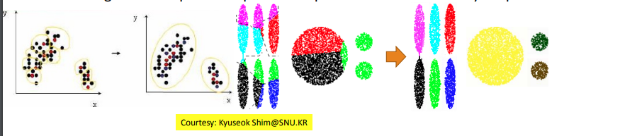
Hierarchical Clustering Me thods
CURE: Clustering Using Well-Scattered Representatives
CURE is an advanced hierarchical clustering method that enhances the robustness and scalability of clustering.
‹#›

Slide 5
Hierarchical Clustering Me thods
CHAMELEON: Graph Partitioning on KNN Graph
CHAMELEON: A graph partitioning approach (G. Karypis, E. H. Han, and V. Kumar, 1999)
Measures the similarity based on a dynamic model
  Two clusters are merged only if the interconnectivity and closeness (proximity) between two clusters are high relative to the internal interconnectivity of the clusters and closeness of items within the clusters
A graph-based, two-phase algorithm
  1. Use a graph-partitioning algorithm: Cluster objects into a large number of relatively small sub-clusters
  2. Use an agglomerative hierarchical clustering algorithm: Find the genuine clusters by repeatedly combining these sub-clusters
‹#›

Slide 6
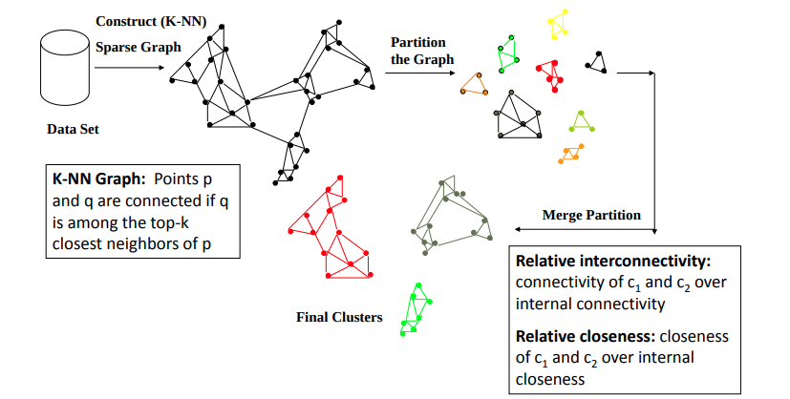
Hierarchical Clustering Me thods
Overall Framework of CHAMELEON
‹#›

Slide 7
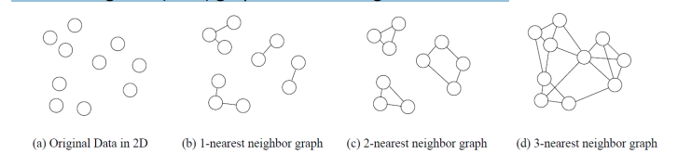

Hierarchical Clustering Me thods
KNN Graphs and Interconnectivity
K-nearest neighbor (KNN) graphs from an original data in 2D:
EC{Ci ,Cj } :The absolute interconnectivity between Ci and Cj :
  The sum of the weight of the edges that connect vertices in Ci to vertices in Cj
Internal interconnectivity of a cluster Ci : The size of its min-cut bisector ECCi (i.e., the weighted sum of edges that partition the graph into two roughly equal parts)
Relative Interconnectivity (RI):
‹#›

Slide 8



Hierarchical Clustering Me thods
Relative Closeness & Merge of Sub-Clusters
Relative closeness between a pair of clusters Ci and Cj : The absolute closeness between Ci and Cj normalized w.r.t. the internal closeness of the two clusters Ci and Cj
  where
are the average weights of the edges that belong to the min-cut bisector of clusters Ci and Cj , respectively, and
is the average weight of the edges that connect vertices in Ci to vertices
in Cj
‹#›

Slide 9
Hierarchical Clustering Me thods
Relative Closeness & Merge of Sub-Clusters
Merge Sub-Clusters:
  Merges only those pairs of clusters whose RI and RC are both above some user specified thresholds
  Merge those maximizing the function that combines RI and RC
‹#›

Slide 10
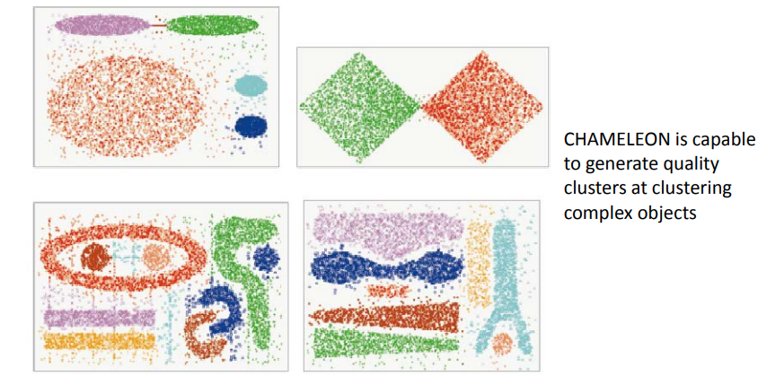
Hierarchical Clustering Me thods
CHAMELEON: Clustering Complex Objects
‹#›

Slide 11
Hierarchical Clustering Me thods
Probabilistic Hierarchical Clustering
Algorithmic hierarchical clustering
  Nontrivial to choose a good distance measure
  Hard to handle missing attribute values
  Optimization goal not clear: heuristic, local search
Probabilistic hierarchical clustering
  Use probabilistic models to measure distances between clusters
  Generative model: Regard the set of data objects to be clustered as a sample of the underlying data generation mechanism to be analyzed
  Easy to understand, same efficiency as algorithmic agglomerative clustering method, can handle partially observed data
‹#›

Slide 12



Hierarchical Clustering Me thods
A Probabilistic Hierarchical Clustering Algorithm
For a set of objects partitioned into m clusters C1, . . . ,Cm,
the quality can be measured by,
where P() is the maximum likelihood
If we merge two clusters Cj1 and Cj2 into a cluster Cj1∪Cj2, the change in quality of the overall clustering is
Distance between clusters C1 and C2:
If dist(Ci , Cj ) < 0, merge Ci and Cj
‹#›

Slide 13
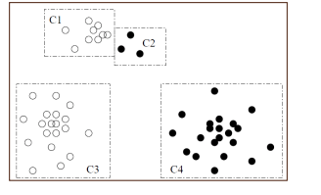
Hierarchical Clustering Me thods
A Probabilistic Hierarchical Clustering Algorithm
‹#›

Slide 14
Hierarchical Clustering Me thods
Probabilistic Hierarchical Clustering Algorithm Steps
Algorithm Steps:
  Probability Representation: Model data points as probability distributions.
  Pairwise Probability: Estimate the probability of one cluster containing another.
  Hierarchy Construction: Build hierarchical structure based on pairwise probabilities.
  Hierarchical Pruning: Prune hierarchy to eliminate unlikely containment relationships.
Probabilistic Hierarchical Clustering adds a layer of uncertainty modeling to the clustering process, enhancing its flexibility.
‹#›

Slide 15
Hierarchical Clustering Me thods
Comparing Advanced Hierarchical Clustering Methods
CURE:
  Uses well-scattered representative points.
  Addresses noise and scalability.
  Suitable for large datasets.
CHAMELEON:
  Leverages KNN graph partitioning.
  Handles complex data distributions.
  Emphasizes inter-cluster and intra-cluster distances.
‹#›

Slide 16
Hierarchical Clustering Me thods
Comparing Advanced Hierarchical Clustering Methods
Probabilistic Hierarchical Clustering:
  Incorporates probability distributions.
  Provides a probabilistic view of clustering.
  Integrates uncertainty modeling.
Choosing the right advanced method depends on data characteristics and the desired insights.
‹#›

Slide 17
Hierarchical Clustering Me thods
Application: Social Network Community Detection
Let's explore an application of advanced hierarchical clustering: detecting communities in social networks.
Objective:
  Identify communities or groups of tightly connected individuals.
  Understand social network structure and relationships.
‹#›

Slide 18
Hierarchical Clustering Me thods
Application: Social Network Community Detection
Steps:
  Graph Construction: Create a graph representing social connections.
  CHAMELEON Clustering: Apply CHAMELEON for community detection.
  Cluster Analysis: Examine formed clusters for meaningful social communities.
  Community Insights: Gain insights into social network dynamics and behavior.
  Advanced hierarchical clustering aids in uncovering hidden patterns and communities within complex networks.
‹#›

Slide 19
Hierarchical Clustering Me thods
Recap and Key Takeaways
CURE enhances clustering robustness and scalability with well-scattered representatives.
CHAMELEON introduces graph partitioning on KNN graphs for complex data distributions.
Probabilistic Hierarchical Clustering integrates probability distributions for uncertainty modeling.
These advanced methods empower us to tackle complex clustering challenges and extract deeper insights from our data.
‹#›

Slide 20
Summary
Hierarchical Clustering
Hierarchical clustering organizes data in a tree-like structure.
Agglomerative starts with individual data points and merges them.
Divisive begins with all data in one cluster and splits iteratively.
Useful for exploring data hierarchy and relationships.
‹#›

